Slide 1

Trend Visualization of Electric Vehicle Adoption for Sustainable Transportation Analysis
DSA0608-Data Handling and Visualization with Statistical Foundations
GUIDED BY :
Dr. Kumaragurubaran . T
Dr. Senthilvadivu. S
Presented By
P.Prasanna sree(192324309)
Jayasri E(192424005)

Slide 2


Introduction
Electric Vehicles (EVs) are transforming global mobility and helping reduce dependence on fossil fuels.
Visualizing EV adoption trends enables understanding of how fast and where the transition toward green transport is happening.
EV data visualization helps policymakers, manufacturers, and consumers make informed decisions.
It supports UN Sustainable Development Goals by promoting clean energy, sustainable cities, and climate action.
This project analyzes EV adoption trends to understand how charging stations, government policies, and consumer demand support sustainable transportation.
02

Slide 3
P Problem Statement
Current State:-
EV adoption is growing worldwide, but available sales and charging-station data is not fully utilized to understand long-term trends in sustainable transportation.
Challenges:-
Incomplete or inconsistent EV sales and infrastructure data.
Difficulty linking policy support, charging availability, and EV growth.
Limited visual tools to clearly interpret adoption patterns over time and regions.
Goal:-
To develop a Python-based system that preprocesses and visualizes EV adoption trends, helping policymakers and researchers make informed decisions for sustainable mobility.

Slide 4
Objectives
To collect and analyze EV registration, charging infrastructure, and emission data.
To visualize growth trends across different years, regions, and vehicle categories.
To compare EV adoption rates among nations and states.
To measure the sustainability impact of EV adoption (e.g., CO₂ reduction, energy savings).
To forecast future EV demand using predictive visualization models.
03

Slide 5
Literature Survey
Studies show that this growth is driven by falling battery costs and government incentives.
Electric Vehicle (EV) adoption has grown rapidly worldwide in the last decade.
Research highlights that countries like China, Europe, and the U.S. lead in EV sales.
Range anxiety and lack of charging infrastructure are major barriers found in multiple studies.
Visualization research commonly uses time-series graphs to show EV sales over different years.
04

Slide 6
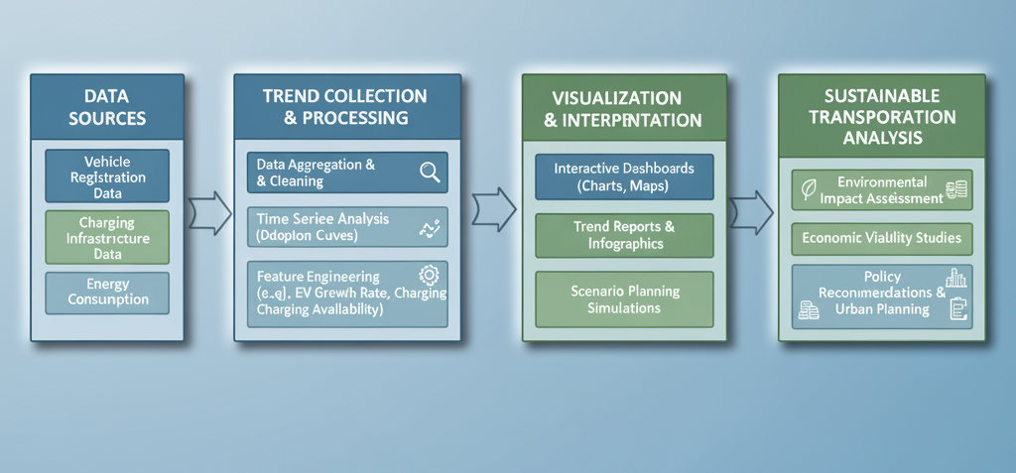
Block Diagram
07

Slide 7
Module-1
Trend Visualization of EV Adoption
Collecting and cleaning EV sales, registration, and charging station data.
Time-series analysis and ARIMA forecasting for adoption trends.
Graphs: line charts, bar plots, and heatmaps to visualize growth.
Comparison between countries, states, or vehicle types.
Identification of top-performing regions and adoption patterns.
Outcome:- Provides clear insights into growth rate, market trends, and regional adoption patterns.

Slide 8
Module-2
Environmental Impact & Sustainability Analysis
Analyzing how increased EV use reduces CO₂ emissions and fossil fuel dependency.
Comparing emission data before and after EV adoption.
Visualization of CO₂ reduction trends and renewable energy integration.
Assessing EV contribution toward UN Sustainable Development Goals (SDG 7, 11, and 13).
Policy recommendations for improving sustainability impact.
Outcome:- Demonstrates how EV adoption supports sustainable transportation and cleaner environments.

Slide 9
Tools / Techniques
Programming:R code
Visualization Tools: Tableau / Power BI for interactive dashboards
Analysis Models: Linear Regression, Time-Series Forecasting
Metrics: EV penetration rate, CO₂ savings, charging station density
Approach: Data-driven insight generation for sustainability decisions

Slide 10
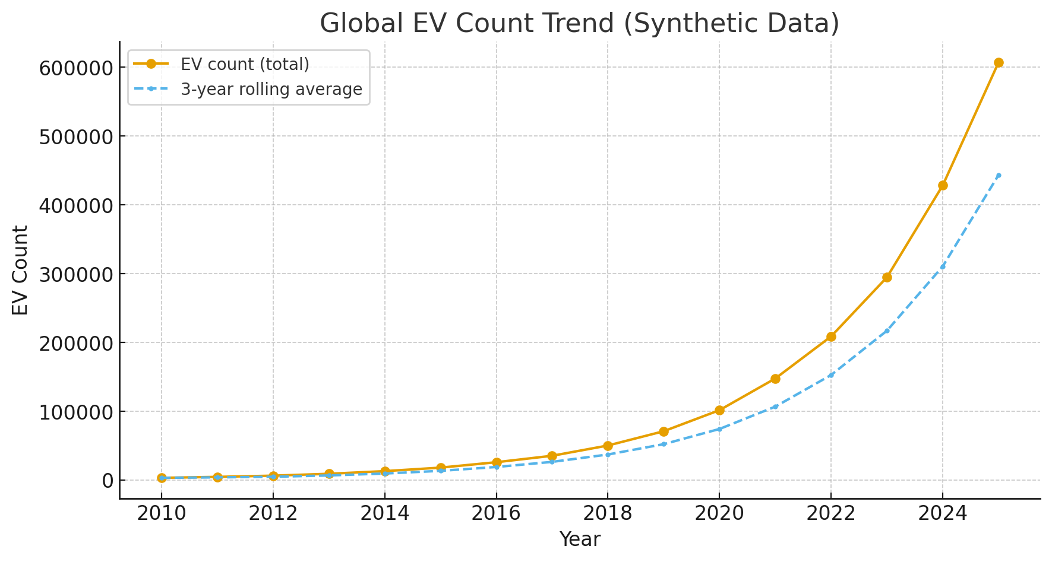
OUTPUT IMAGE

Slide 11
Conclusion
EV adoption visualization enables evidence-based decision-making for sustainable transport.
Data shows a clear positive transition toward clean mobility worldwide.
Policy, infrastructure, and public awareness drive adoption rates.
Effective trend visualization bridges the gap between data and sustainable action
The study confirms that data visualization is an effective tool to identify adoption gaps and future opportunities for growth.
13

Slide 12
Future Work
Build real-time EV monitoring dashboards linked to government data.
Integrate geospatial analysis for charging network optimization.
Use AI and Machine Learning for predictive adoption modeling.
Extend analysis to include battery recycling and renewable energy integration.
Develop a mobile-friendly dashboard for public awareness and EV incentives.
Extend visualization to include battery life cycle, recycling, and supply chain sustainability.

Slide 13
References
International Energy Agency (IEA) (2024). Global EV Outlook 2024 – Accelerating Ambitions for Electric Mobility.
NITI Aayog, Government of India (2023). EV Policy and Roadmap for India – Sustainable Mobility Mission 2030.
Statista Research Department (2024). Electric Vehicle Market Growth and Charging Infrastructure Statistics.
Zhang, L., & Li, M. (2023). “Data-Driven Visualization Techniques for Sustainable Transportation Systems.” IEEE Access Journal.
Wang, Y., et al. (2022). “Electric Vehicle Adoption and Infrastructure Expansion: A Global Analysis.” Elsevier – Energy Policy Journal.
World Bank Group. (2023). Global CO₂ Emission Reduction through Electrified Transport.
Ma, R., et al. (2024). “Predictive Modelling of EV Trends Using Data Analytics.” Springer – Sustainable Computing: Informatics and Systems.
International Council on Clean Transportation (ICCT). (2024). EV Uptake and Policy.
14

Slide 14
Thank You

